Slide 2
Tips & Tricks for .NET Debugging in Visual Studio
Leslie Richardson
Program Manager, VS Debugging
@lyrichardson01

Slide 3
Demos!

Slide 4
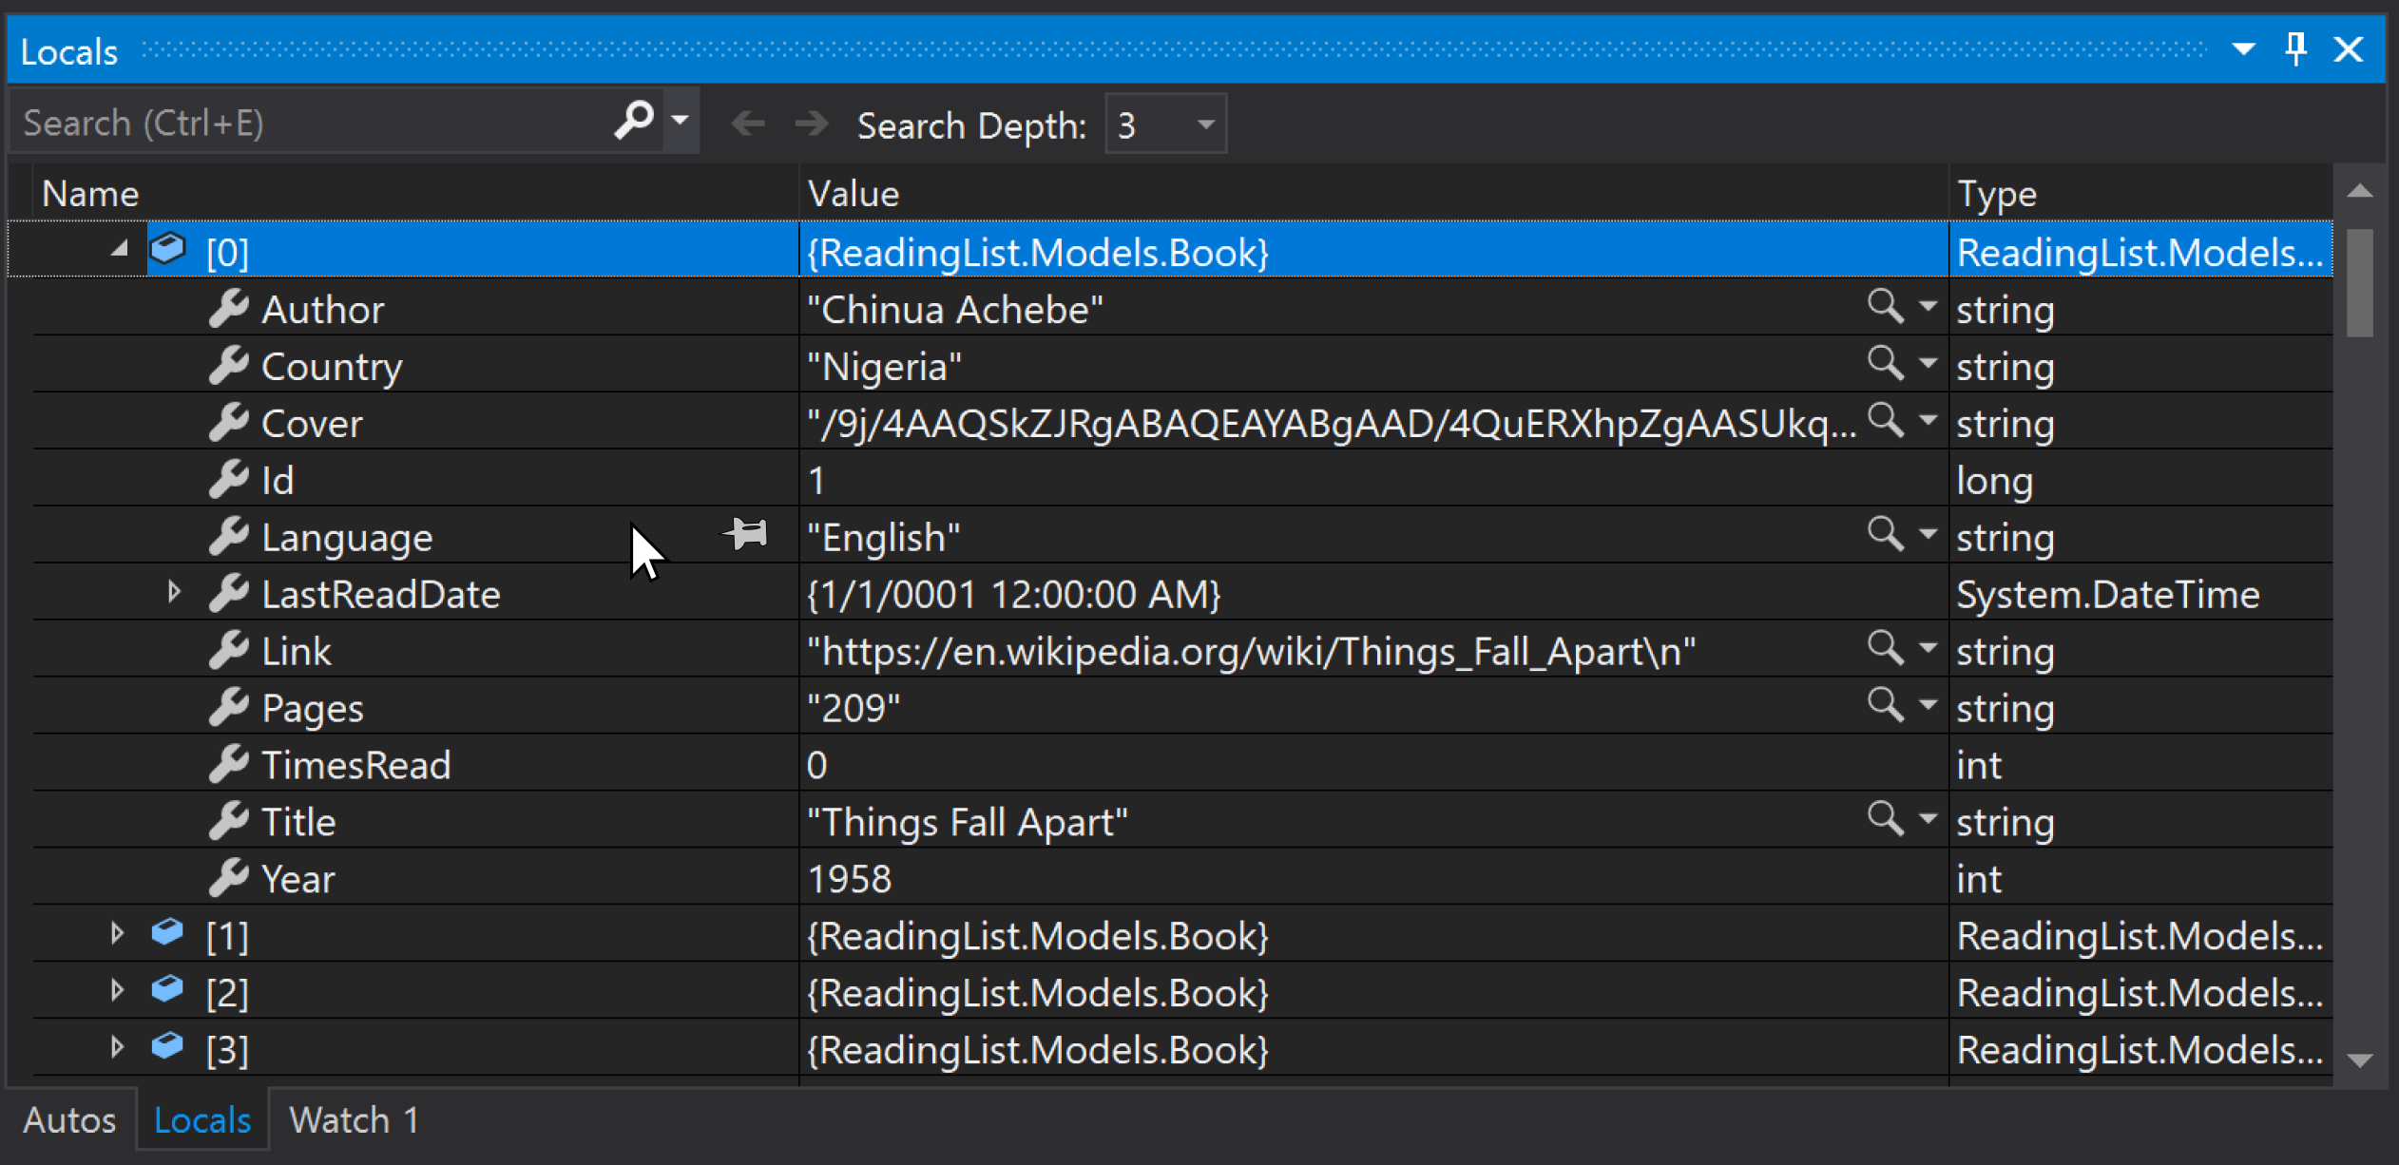

Slide 5
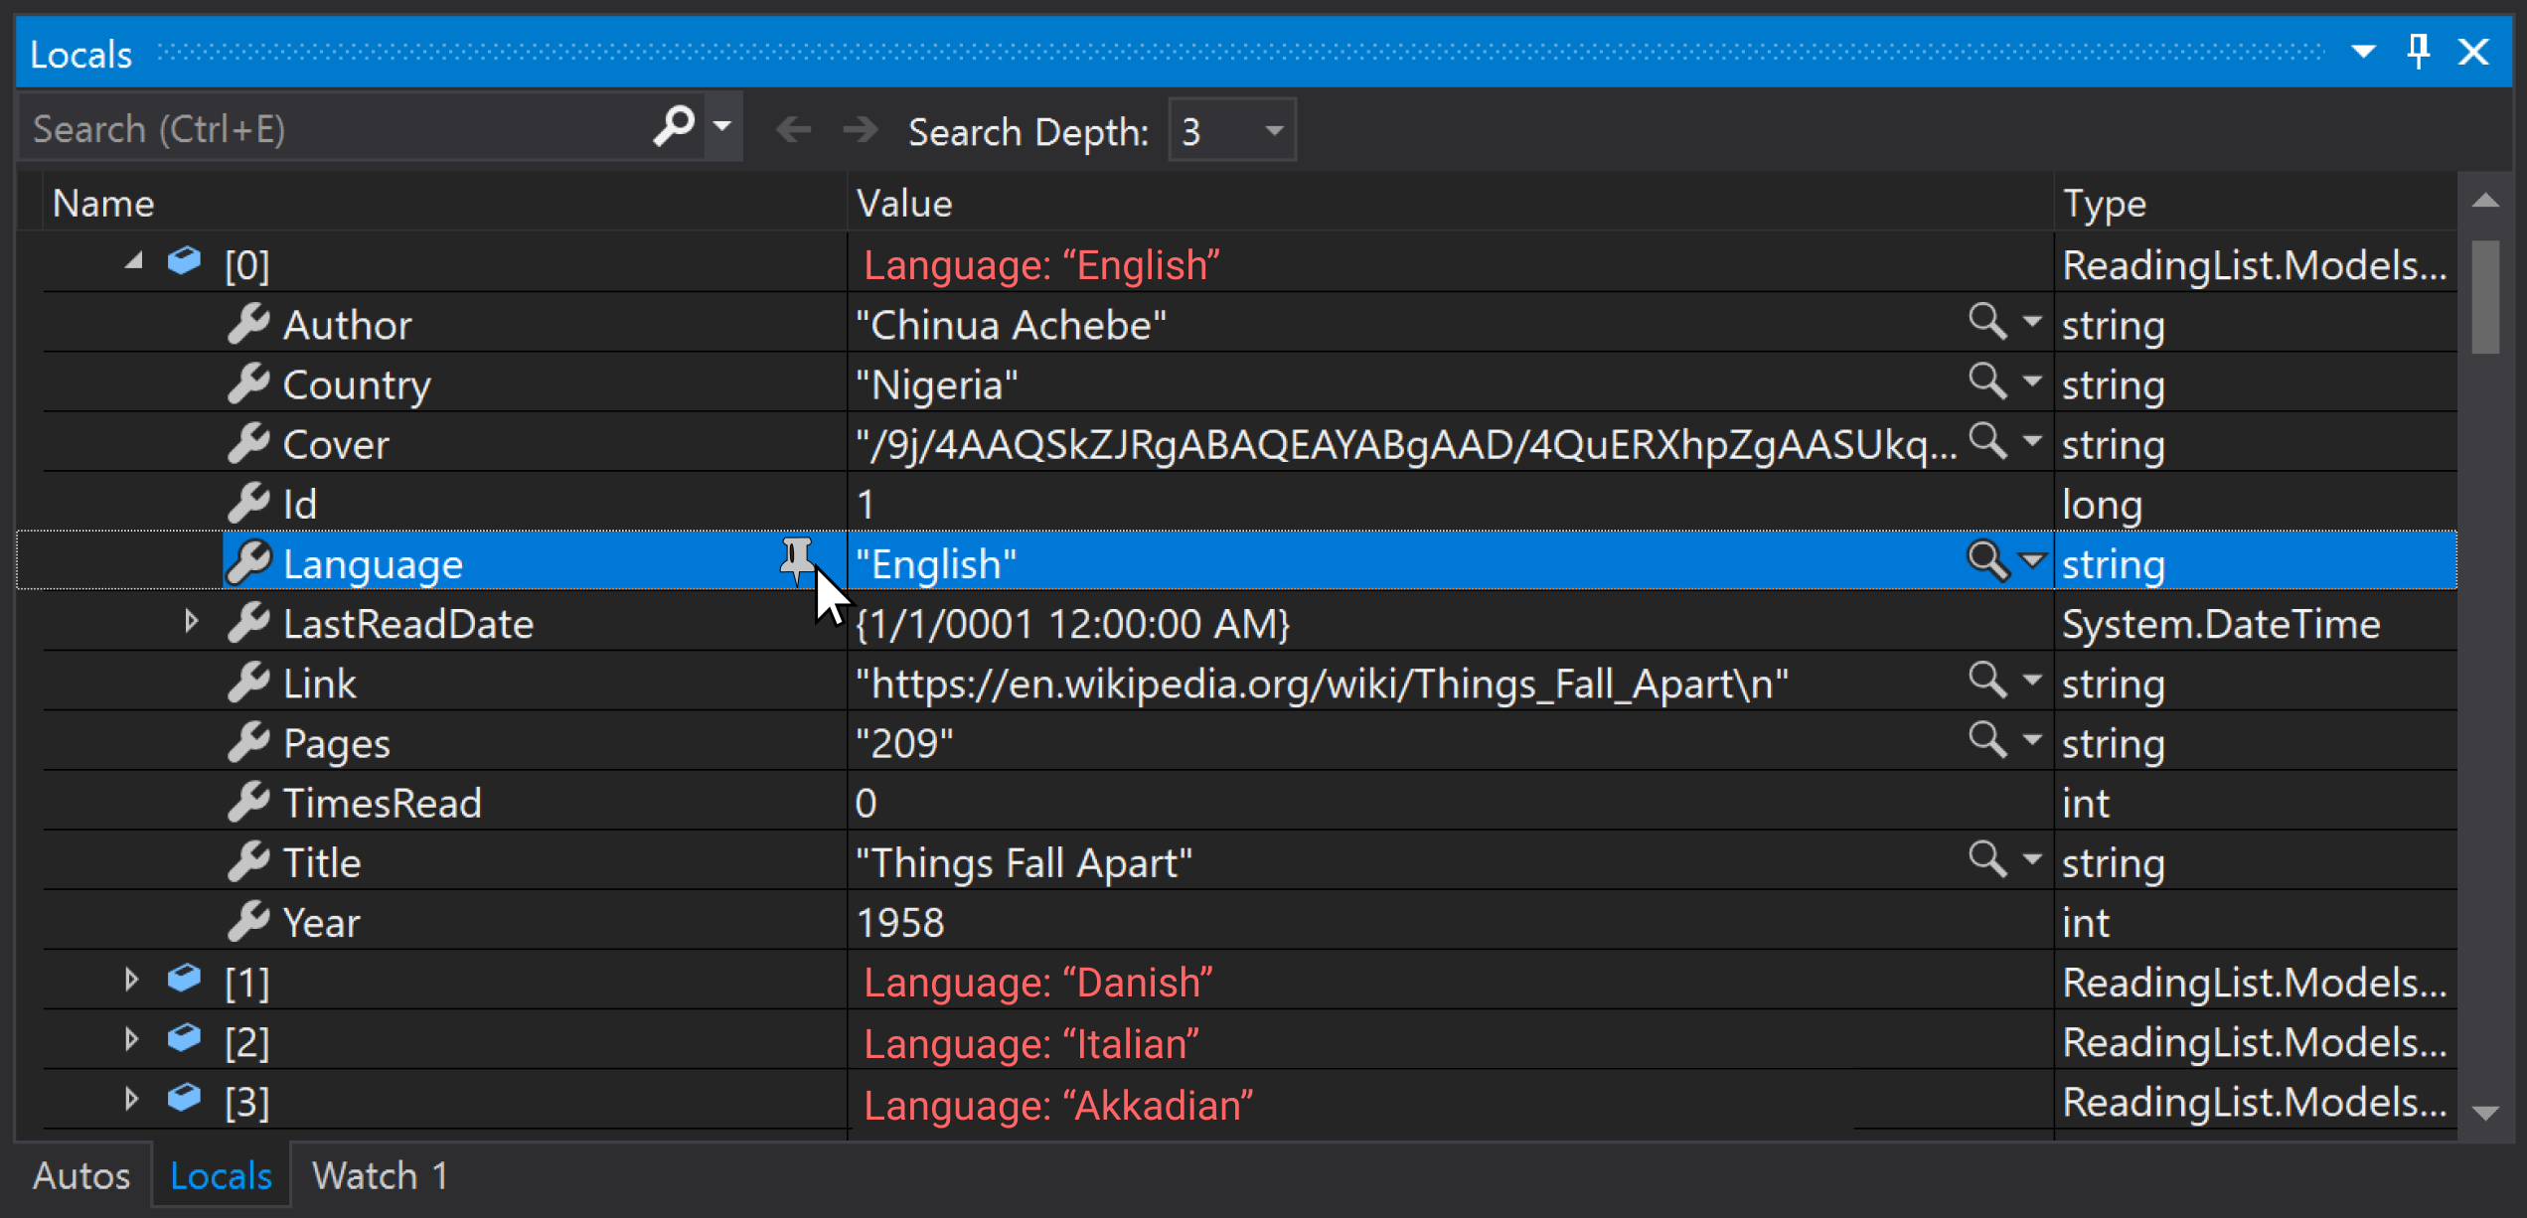

Slide 7
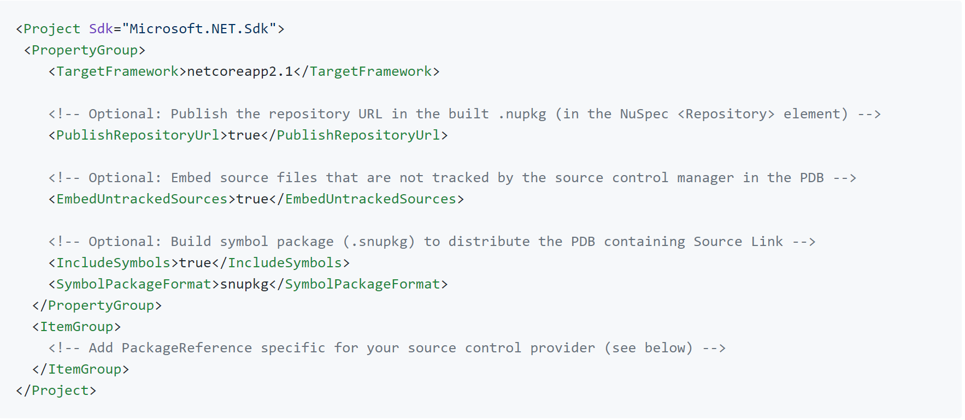
Source Link

Slide 8
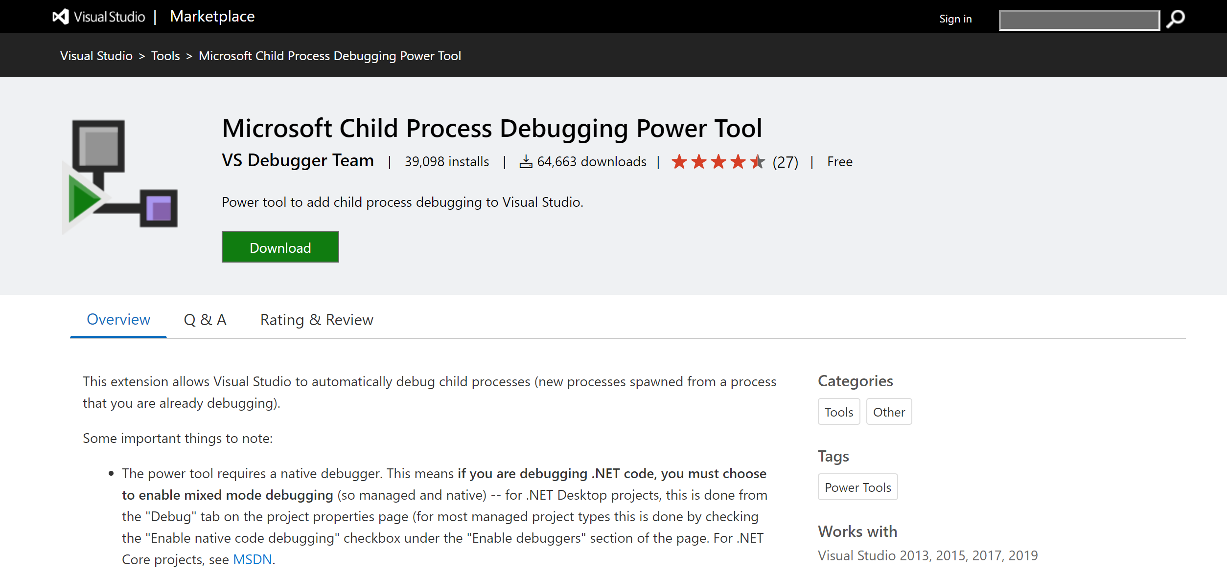
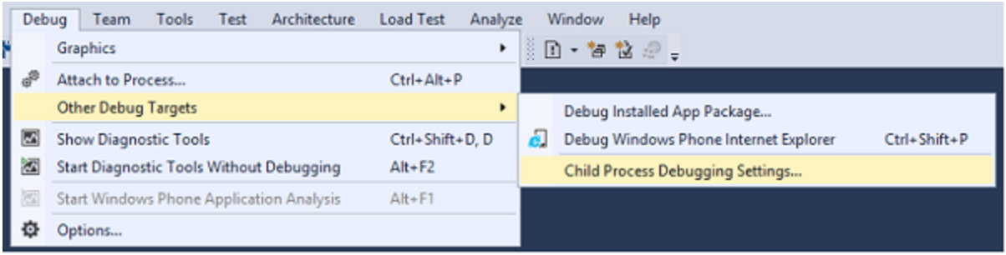

Slide 9
Demo Repo
Master: https://github.com/leslierichardson95/reading-list/tree/master/src/ReadingList
Async Branch: https://github.com/leslierichardson95/reading-list/tree/Async/src/ReadingList

Slide 10
Questions?

